Slide 1


Exploring the Use of Purely Functional Programming Languages for Offloading of Mobile Computations
By Christian Kjær Laustsen (s124324)

Slide 2
Outline
Offloading
Approaches
Evaluation
Discussion & Conclusion

Slide 3
Offloading

Slide 4
Motivation
Offloading
Consumers expect
more and more performance from their devices,
a small/thin device size,
the battery capacity to improve (or at least not regress),
Why is this a problem?
Performance improvements have gone far faster than battery improvements.
Form factor (small device) limits size of components, especially battery
What if we could save energy and increase performance by running our code elsewhere?

Slide 5
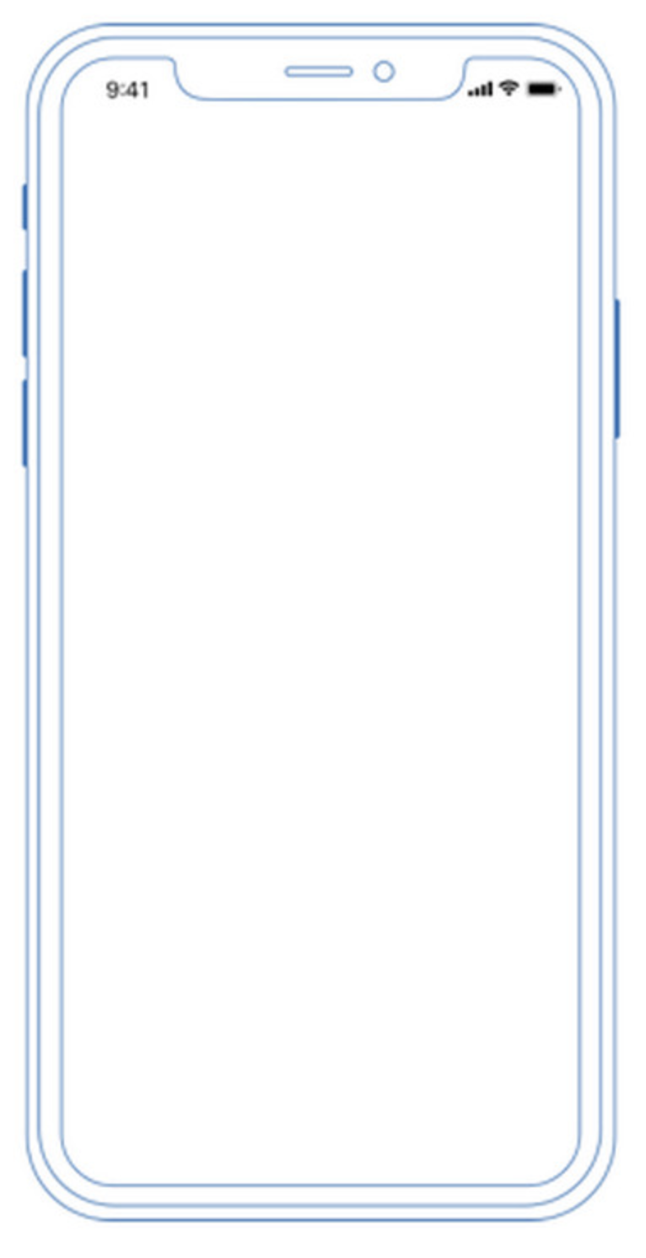
Offloading
Offloading
What are we working with?
Local/Mobile Layer
Network Layer
Remote/Cloud Layer
4G/3G/2G
Server
Server
WiFi
Server

Slide 6
Offloading
Offloading
Network Layer means we care about
Latency, throughput/bandwidth, packet loss
Often tied to network type (2G, 3G, 4G, WiFi)
Mobile Layer means we care about
Execution time, battery drain
Cloud Layer means we care about
Round-trip times to remote location

Slide 7
Previous Solutions
Offloading
Most of the previous solutions wrestle with handling state
MAUI and CloneCloud traverse and transfer the state upon offloading
UpShift keeps the state in sync, unidirectionally
MobiCOP requires the programmer to supply the state
All feature profilers/decision-engines
Most are dynamic at runtime and learn, but possible to do it statically (CloneCloud)
Adoption is still very low

Slide 8
Pure FP Languages
Offloading
Purity and pure functional programming languages can help us alleviate the problem with state, and maybe adoptability too
Let us explore how we could go about this!

Slide 9
Approaches

Slide 10
Layers → Program
Approaches
We need to consider all three layers
Each layer corresponds to a part of the program
Local/Mobile Layer
Network Layer
Remote/Cloud Layer
Client-side
Profiler/Decision Engine
Server-side

Slide 11
Approaches
Approaches
Explore several solutions to the problem space
Considerations (learned from previous literature and solutions)
Input/output size matters
Buy-in, granularity and portability matters to adoptability
Traversing and handling state is a complex issue
Network conditions can change frequently
You probably don’t want to offload on 2G
On 3G you strongly need to consider input/output size
4G and WiFi have favourable conditions for offloading

Slide 12
Evaluating Approaches
Approaches
Approach | Complexity | Adoptability | Buy-in | Granularity | Server-side story | Portability
Extending the runtime | Very High | Low | High | Very Coarse | No | No
unsafePerformIO | Low | Mid | Low | Very Fine | No | Yes
Rewrite Rules | Low | Low | Low | Very Fine | No | No
Monadic Framework | Mid | High | Mid | Flexible | Yes | Yes
Template Haskell | High | Mid | Low | Very Fine | Yes | No

Slide 13
Why go with Monadic Framework?
Approaches
The Free/Freer-style is already being used for general code structure
MTL has the drawback of allowing functions defined outside of the set of operations
It has a fairly low complexity and retains portability across other pure FP languages
One of the few that presents a server-side story
The granularity is very flexible
Provides the cleanest separation between program semantics and implementation

Slide 14
Why go with Monadic Framework?
Approaches
We can easily write a effectful interpreter, pure interpreter, testing interpreter, server interpreter, etc
Effectful Interpreter
Output
Program
Pure Interpreter
Profiling Interpreter
Debug Interpreter
Server Interpreter

Slide 15
Evaluation

Slide 16
Criteria For Success
Evaluation
Three main criteria we will evaluate our approach on
Lower Energy Consumption
Less battery drained
More performance
Faster execution
Complexity of testing 1. and 2.
Who much work is involved in evaluation the effectiveness

Slide 17
Testing Setup
Evaluation
Construct two interpreters on the client
One that offloads
One that runs locally
Run each interpreter while gathering diagnostics (over WiFi)
Compare results

Slide 18
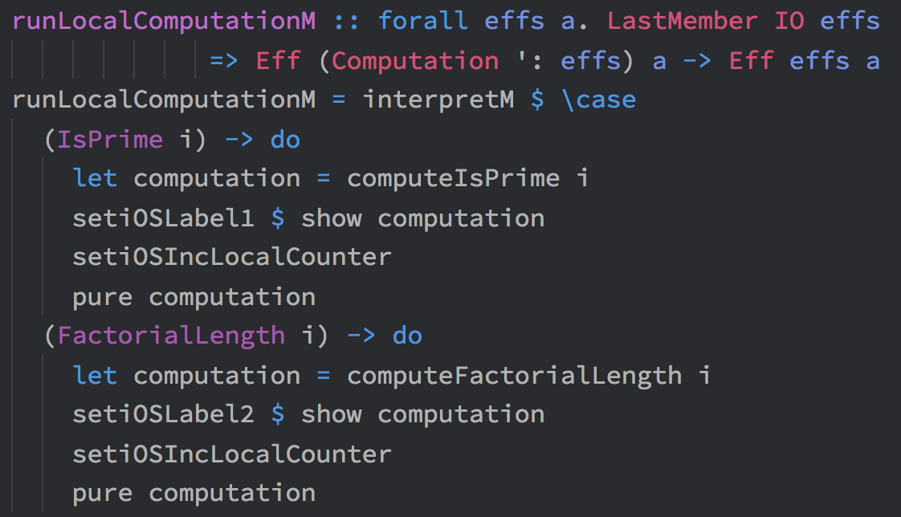
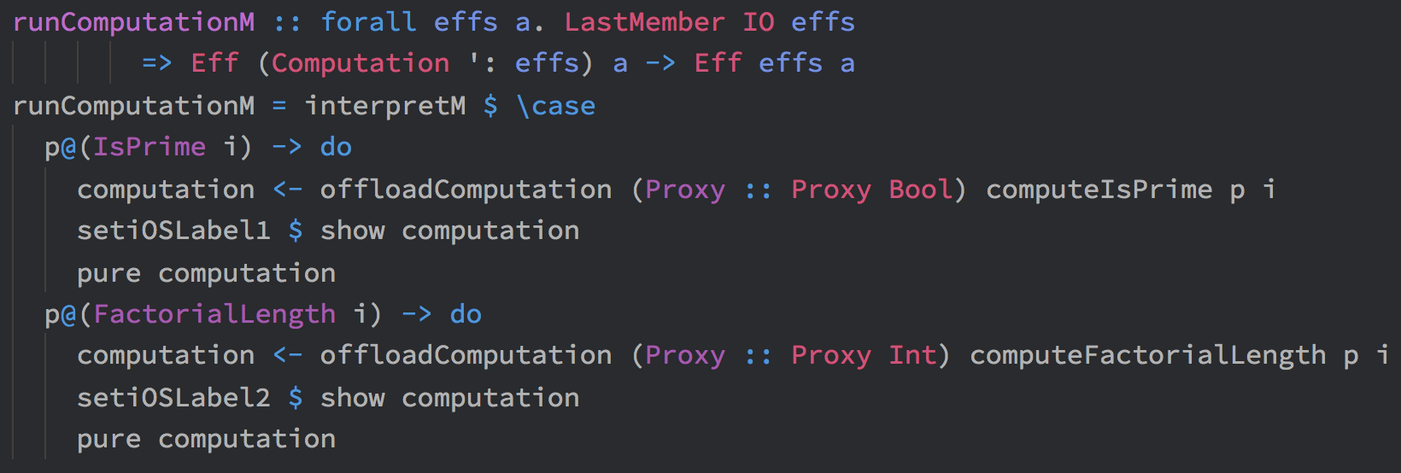
Testing Setup
Evaluation
Reuse as much code for the interpreters as possible
Just one line changed
Effectively the same code (can even just set the profiler to False)
Very simple to mock user input if needed

Slide 19
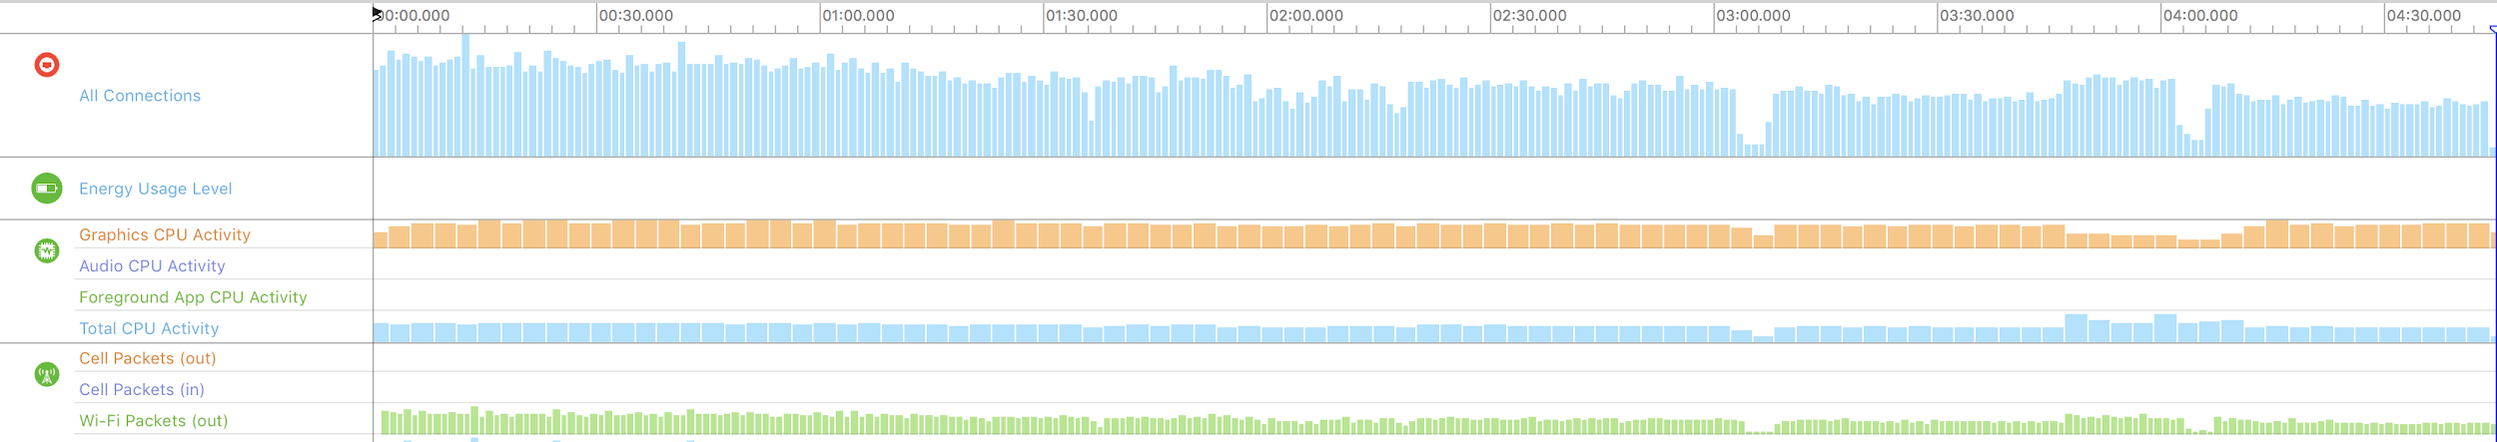
Measurements: Offloaded
Evaluation
Runtime: 4:45 minutes
Energy: 10/20 (average)
CPU: 45% (average)
GPU: 10% (average)
Network: 4.58 MiB Transferred (total)

Slide 20
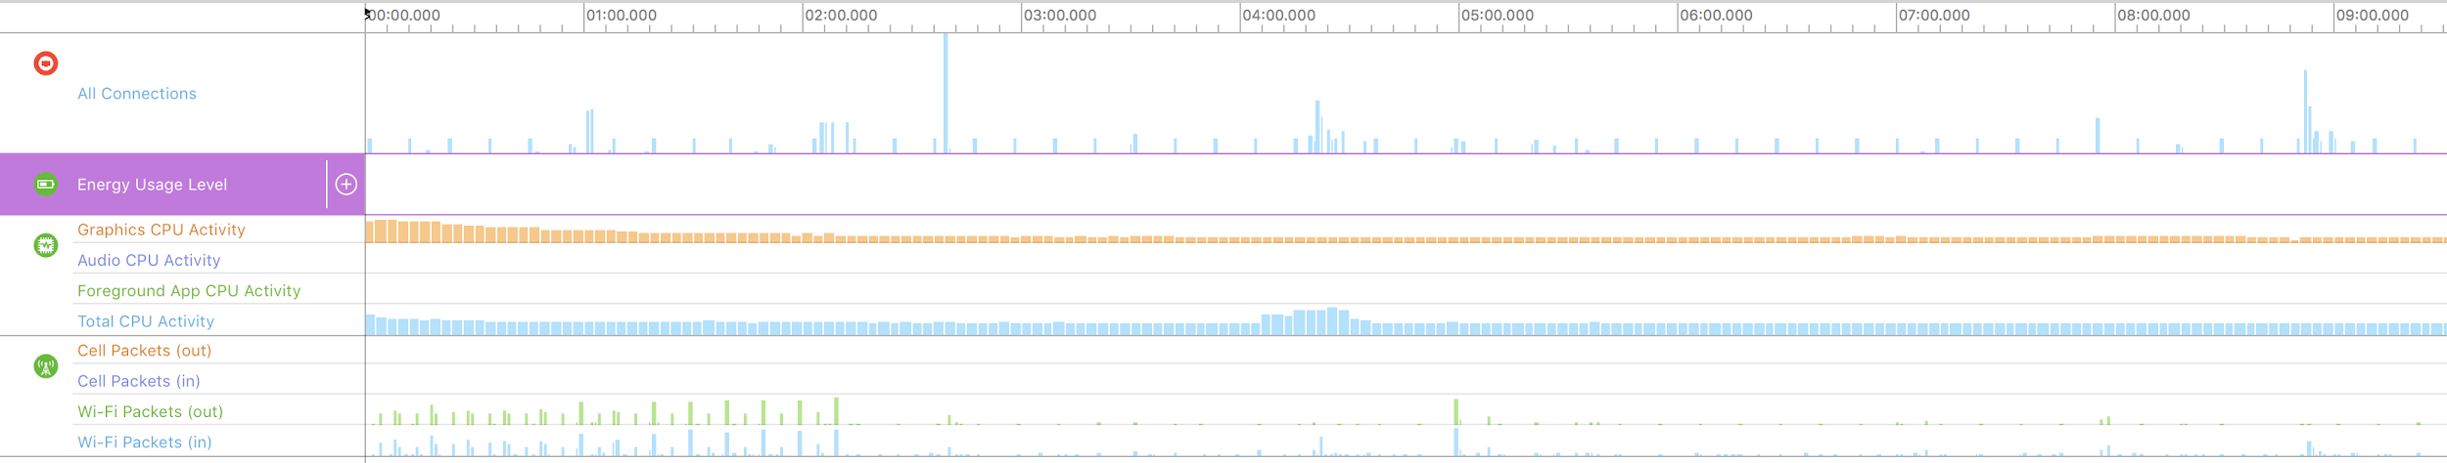
Measurements: Local
Evaluation
Runtime: +11:00 minutes
Energy: 15/20 (average)
CPU: 38% (average)
GPU: 5% (average)
Network: 82.95 KiB Transferred (total)

Slide 21
Measurements: Comparison
Evaluation
Local
Runtime: +11:00 minutes
Energy: 15/20 (average)
CPU: 38% (average)
GPU: 5% (average)
Network: 82.95 KiB Transferred (total)
Offloaded
Runtime: 4:45 minutes
Energy: 10/20 (average)
CPU: 45% (average)
GPU: 10% (average)
Network: 4.58 MiB Transferred (total)
Comments
Local is +6:15 minutes slower
Local energy consumption is 50% higher than offloaded
CPU and GPU utilization is lower on local (GPU because of slower UI repaints)
Network transfer is of course far higher when offloading (no more than a high-res JPG image)
Local slows down around ~3:00 minutes, and very much after ~7:00 minutes

Slide 22
Apple Guidelines on Mobile Battery Leaks
Evaluation
Battery drain ← from keeping the device running longer (local) and from networking (offloading)
Activity when you expect your app to be idle
An unresponsive or slow user interface
Large amounts of work on the main thread ← the need to run computationally intensive code on the device (local)
High use of animations
High use of view opacity
Swapping
Memory stalls and cache misses
Memory warnings
Lock contention
Excessive context switches
Excessive use of timers
Excessive drawing to screen ← side effect of executions going faster (offloading), but can’t say it’s a problem
Excessive or repeated small disk I/O
High-overhead communication, such as network activity with small packets and buffers ← with the need to communicate (offload)
Preventing device sleep ← because of longer execution durations (local)

Slide 23
Discussion & Conclusion

Slide 24
Discussion
Discussion & Conclusion
Even though our average CPU utilization is higher, we still see clear gains by offloading, particularly when execution time increases
Other factors like memory, CPU idle time, etc, might affect
Evaluating/profiling our program did not touch the program itself, only the interpreters
We have full control over our effects because of purity
Haskell is still very much in the early stages for usage on mobile devices (via Cross-compilation)!

Slide 25
Conclusion
Discussion & Conclusion
By utilizing a pure functional programming language, we can get rid of the need to worry about state
We are able to construct just one program that is used for both running our actual code, and evaluating its effectiveness
Mobile devices impose interesting considerations:
Trade-off between which components to keep active (CPU, Screen, Network)
Code needs to run on ARM
Latency matters a lot in instances of UI interactions

Slide 26
Thank You!

